Slide 1

Managing conflict
Recall DNA:
What is consent?
Consent is …
2. Explain how consent can be given and taken away?
Consent can be given, and it can be taken away because...
3. Give an example of how you have or have not given consent this week...
I have/have not given consent this week when...

Slide 2

Key Words
Conflict
a serious disagreement or argument
Communication
process by which information is exchanged between individuals through a common system of symbols, signs, or behaviour

Slide 3



What are we learning?
We are learning about skills to manage relationship conflict in our everyday lives
Why?
So we can use tools to effectively manage conflict throughout school and adult life

Slide 4
1. How does it feel to argue or disagree with people?
3. Why does the way we respond to conflict matter?
2. How might this impact on people’s actions?
4. What tips can we share for responding to conflict?

Slide 5
Conflict management solutions
• Supporting own wellbeing so better able to deal with conflict when it happens
• Pausing to reflect before responding
• Communicating effectively
• Seeing things from different perspectives
• Coming up with different practical ‘win-win’ solutions
• Negotiating and compromising where safe and fair to do so
• Stepping away from escalating situations (where people seem to be getting more and more angry)

Slide 6
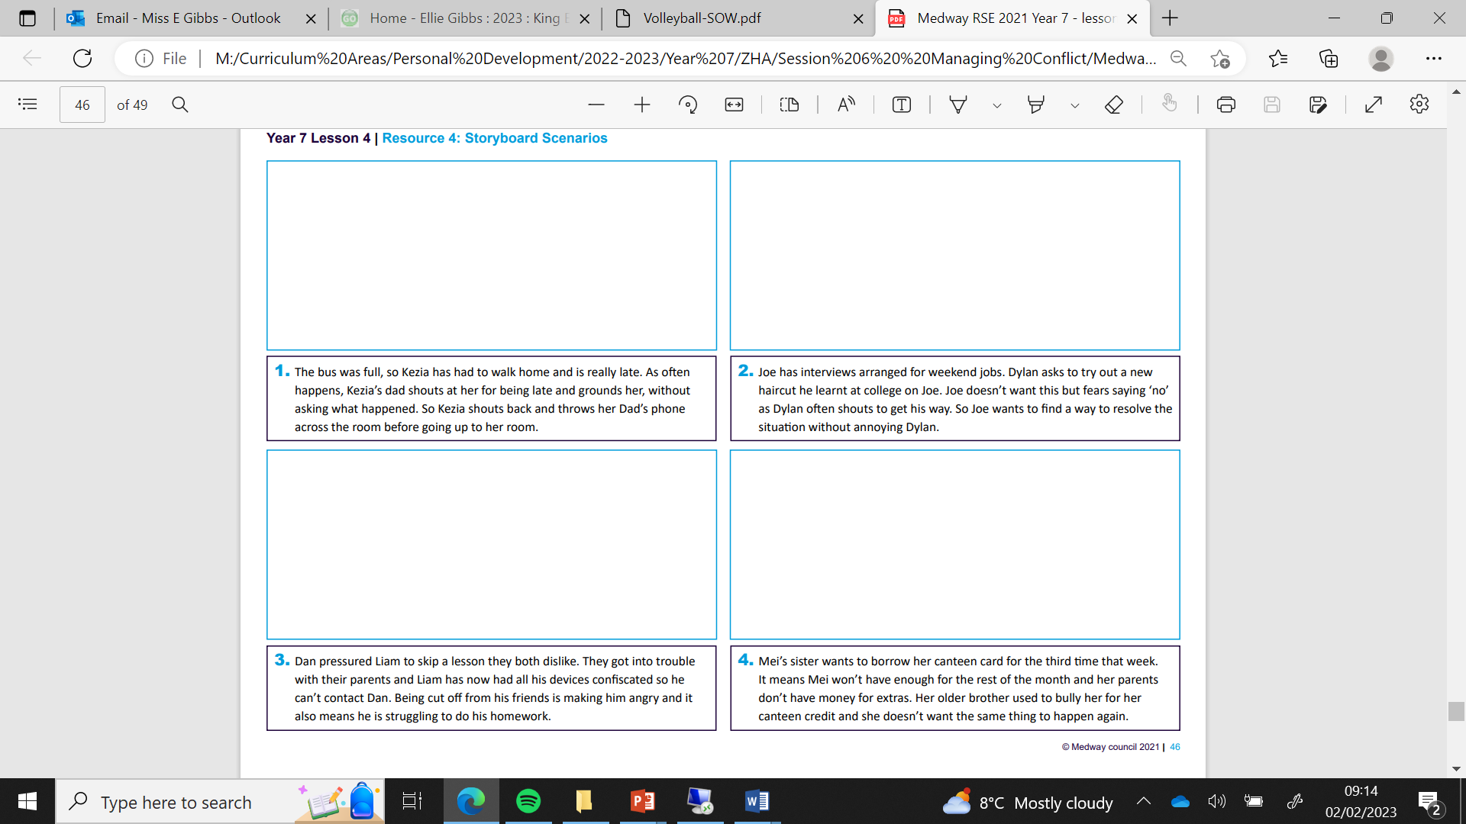
Story board – use pencils to draw a solution

Slide 7
Conflict solutions
In your book, write the following:
An example of how conflict could be managed effectively in your own life. Think of a previous experience perhaps and how you could handle it better in the future.
If you are struggling, try to think of something you might have seen by someone else and try to think of how they could have resolved the issue better

Slide 8


Signposting support
If you would like further guidance or support:
speak to a parent/carer, tutor, head of year, school nurse/counsellor or other trusted member of staff in the school
Visit:
A Better Medway: www.abettermedway.co.uk
Brook: www.brook.org.uk 0808 802 1234
Childline: www.childline.org.uk 0800 1111
Adfam: www.adfam.org.uk 0800 0086 811

