Slide 1
What is the local labour market?
Why do I need to know about it?:
Key words to support your recall questions
Enjoyment
Skills
Capable
Location
Longevity
Training
Qualifications
Personality
Task 1 DNA Quiz
Please complete the DNA Quiz and stick under your date and title
Task 2 Recall Activity
What things should you consider when choosing a career?
When choosing a career, you need to consider …………
Why is it important to do your research on a career?
It is important to do your research on a career because …………

Slide 2
L:O
What – To describe and explain what the Local Labour Market is and why we need to know about it.
Why – To make informed choices about what skills and qualities are needed to be successful in the world of work.

Slide 3
In today’s session
Distinguish different types of labour market information (LMI).
Gain an understanding into the job sectors in demand in West Midlands
Reflect upon skill shortages.

Slide 4

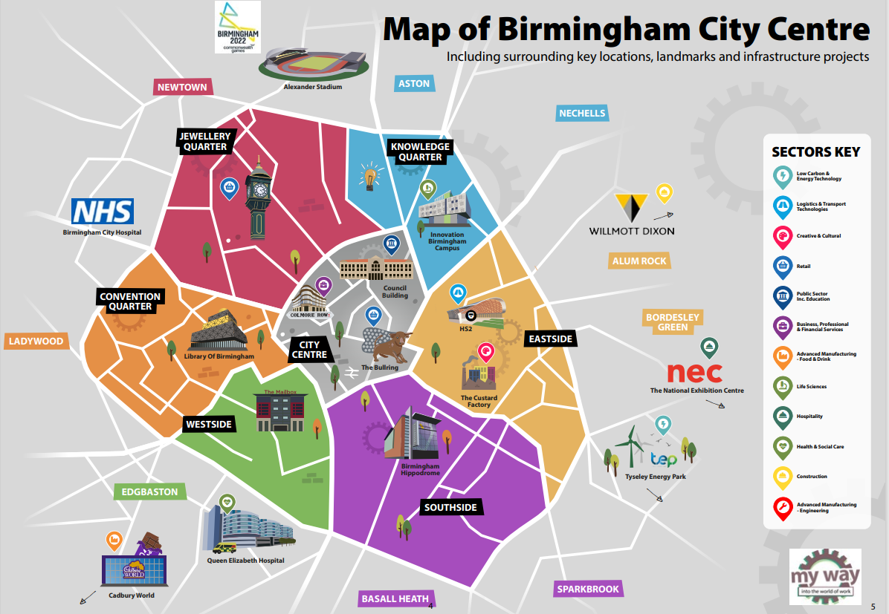
What is the local labour market?
The local labour market represents the set of jobs for which an unemployed worker could apply for in their area. It highlights which job sectors have the most openings and which job sectors are in the least demand. This can help influence your future career decisions.

Slide 6
Task 1 and 2 in your booklet
Labour Market
LMI
Sector
Industry
Career
Job Role
Complete the section in on your worksheet matching the definitions to the key words.

Slide 7
Definitions
A collection of companies/businesses that carry out very similar business activities.
A broad section of the economy under which a wide range of different companies can be categorized i.e. health, transport or leisure.
Labour Market Information: useful information used to inform careers decisions.
The job or series of jobs you do over the course of your working life, especially if you continue to get better jobs and progress to more senior positions.
A detailed description of what a person does in their specific job including key tasks and responsibilities.
The number of people in a location who are able/willing to work and the number/type of jobs open to them.

Slide 8
Answers
4. A collection of companies/businesses that carry out very similar business activities.
3. A broad section of the economy under which a wide range of different companies can be categorized i.e. health, transport or leisure.
2. Labour Market Information: useful information used to inform careers decisions.
5. The job or series of jobs you do over the course of your working life, especially if you continue to get better jobs and progress to more senior positions.
6. A detailed description of what a person does in their specific job including key tasks and responsibilities.
1. The number of people in a location who are able/willing to work and the number/type of jobs open to them.

Slide 9
What industries can you think of that are locally based to Frankley?
Now think of what industries there are in Birmingham?

Slide 10
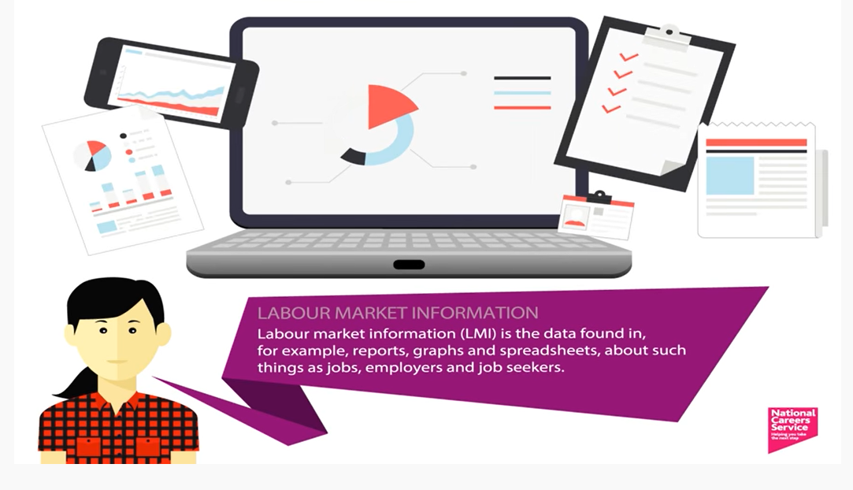
Learning from labour market information
https://bwa.kevibham.org/careers/

Slide 11
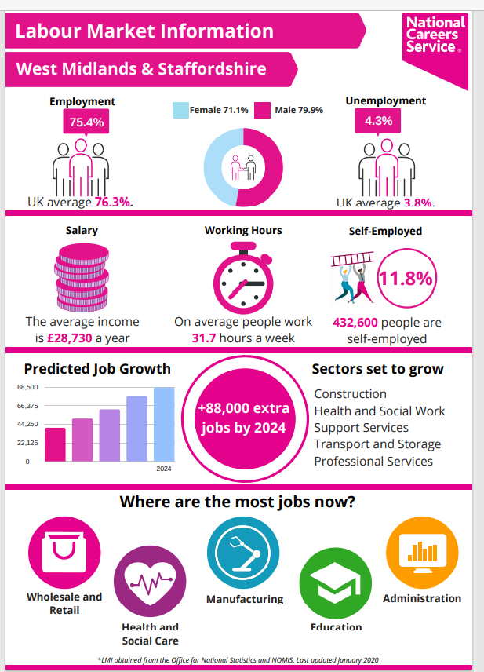
Where can you find local labour market information
National Careers Service
Our school website
Local newspapers
Recruitment websites
  Indeed
  Total jobs
  Reed
Directories i.e. yell.com
Social Media
  LinkedIn
  Twitter
https://bwa.kevibham.org/careers/

Slide 12
Volunteer to read
Local labour Market West Midlands
Sectors set to grow
  Construction
  Health and Social Work
  Support Services
    Support services are those function of organisation which does not generate main business. Support services provide internal support to the main business of organisation. Generally HR, Finance, Logistics, Admin and IT
  Transport and storage
  Professional Services
    Professional services firms exist in many different industries. They include lawyers, advertising professionals, architects, accountants, financial advisers, engineers, and consultants.

Slide 13

And anything digital

Slide 14
Volunteer to read
Where are the jobs right now?
Wholesale and Retail
As you will all know in terms of the high street this area has been impacted heavily by COVID and in next years labour Market information we would see this dip heavily
However supermarket chains have all continued to grow and recruit during COVID
Health and Social Care
Manufacturing
Education
Administration

Slide 15
Volunteer to read
What sectors has COVID-19 affected?
The labour market has suffered significant damage, particularly in the arts
Many key graduate employment sectors - in health, social care, IT, business services - have been much less affected than other areas of the economy.
Nursing, medicine, IT and housing/welfare are all still in demand.
There are notable engineering shortages in the West Midlands. Sales staff, nurses and human resources and industrial relations officers are also in short supply.

Slide 16
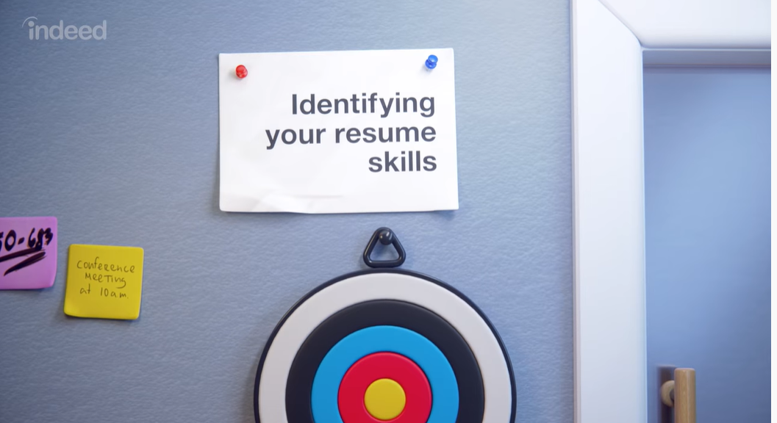
Skills requirements – when moving into employment what skills are they asking for?
Teamwork/Collaboration
Creativity
Problem Solving
Risk Taking
Independence
Organisational
Time Management
Emotional intelligence
Negotiation
Time management
Public speaking – presentation skills
Resume is the same as CV

Slide 17
Negotiation
Public speaking – presentation skills
Teamwork/Collaboration
Creativity
Emotional intelligence
Independence
Risk Taking
Problem Solving
Time management
Organisational
working together (cooperating) with others to get to an end goal.
when a person addresses a group of more than one, without interruption, and takes responsibility for the words and ideas being expressed.
is the process of organising and planning how to divide your time between specific activities.
is the ability to understand, use, and manage your own emotions in positive ways to relieve stress, communicate effectively, empathise with others, overcome challenges and defuse conflict.
it means coming to an agreement through discussion
to arrange or order things so that they can be found or used easily and quickly : to put things into a particular arrangement or order
not having to depend on anyone or anything else.
is someone who risks everything in the hope of achievement or accepts greater potential for loss in decisions and tolerates uncertainty.
is the act of defining a problem; determining the cause of the problem; identifying, prioritizing, and selecting alternatives for a solution; and implementing a solution.
is the ability of a person or group to make something new and useful or valuable, or the process of making something new and useful or valuable.
Task 3 in your booklets

Slide 18
Negotiation
Public speaking – presentation skills
Teamwork/Collaboration
Creativity
Emotional intelligence
Independence
Risk Taking
Problem Solving
Time management
Organisational
working together (cooperating) with others to get to an end goal.
when a person addresses a group of more than one, without interruption, and takes responsibility for the words and ideas being expressed.
is the process of organizing and planning how to divide your time between specific activities.
is the ability to understand, use, and manage your own emotions in positive ways to relieve stress, communicate effectively, empathise with others, overcome challenges and defuse conflict.
it means coming to an agreement through discussion
to arrange or order things so that they can be found or used easily and quickly : to put things into a particular arrangement or order
not having to depend on anyone or anything else.
is someone who risks everything in the hope of achievement or accepts greater potential for loss in decisions and tolerates uncertainty.
is the act of defining a problem; determining the cause of the problem; identifying, prioritizing, and selecting alternatives for a solution; and implementing a solution.
is the ability of a person or group to make something new and useful or valuable, or the process of making something new and useful or valuable.

Slide 19
Bold Question - Scenario
You are a careers advisor in a Job Centre. A client of yours does not know which jobs are available or which jobs would suit them. What advice would you give them and why?
The advice I would give to my client to help them find a job would be ……………….

Slide 20

RIN
Review it Now
What is the local labour market?
  The local labour market is …………
Why is it useful to know the local labour market?
  It is useful to know the local labour market because …………
What skills are employers asking for?
  The skills that employers are asking for are …………

