Slide 1
Parenting and family life
DNA:
What does the law state around consent?
Who CANNOT consent?
What is everyone's right regarding consent?

Slide 2



      We are learning about the responsibilities of being a parent and how committed, stable relationships can be important for bringing up children
      We will be able to:
Describe the benefits of being in a committed, stable, positive relationship
Identify the rights, roles and responsibilities of parents with respect to raising children
Evaluate the characteristics of successful parenting
Notes:
Teacher Notes – Learning objective and outcomes
Introduce the learning objectives and outcomes

Slide 3
The environment a child grows up in is NOT important to their development
True
False
Many things affect how a child will grow up, but the environment provided by parents and carers plays a crucial role.

Slide 4
Parenting
Mind map
Independently, mind map around the word ‘parenting’.
Consider what parenting means and what it might look like in practice.
Remember, parenting doesn't just mean a mother and a father.
Notes:
Teacher Notes - Baseline assessment (5 mins)
Working on their own, ask students to mind map around the word ‘parenting’, considering what this means and what it might look like in practice. This will give you the opportunity to gauge students’ existing understanding, beliefs and attitudes.
They should then have a paired discussion, followed by whole class feedback. Draw out any common ideas that students have about parenting (e.g. genders and ages of the parents, what parents should do for their children etc.). Students should not add anything to their mind map during the discussions as they will revisit this baseline activity at the end of the lesson.

Slide 5
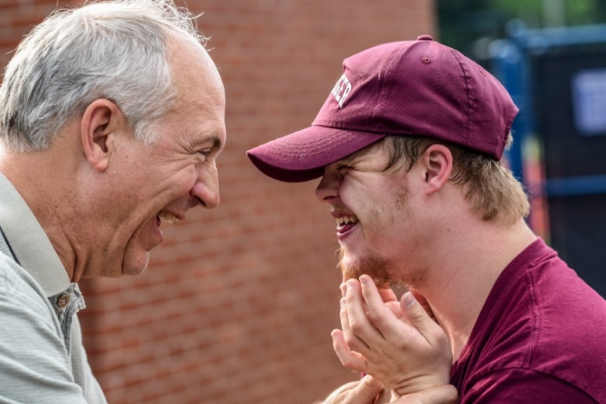

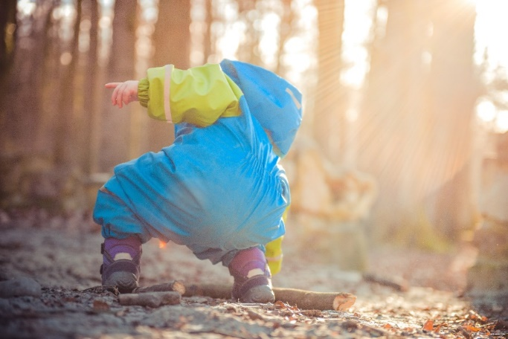
Parental responsibilities
Do you think anything is missing from this list?
providing a home for the child
protecting and maintaining (caring for) the child
disciplining the child
choosing and providing for the child’s education
agreeing to the child’s medical treatment
naming the child and agreeing to any change of name
looking after the child’s property
Notes:
Teacher Notes – Parental responsibilities (5 mins)
Explain to students that there are some key legal rights and responsibilities that parents have, called ‘parental responsibilities .’ According to www.gov.uk, these are:
providing a home for the child
protecting and maintaining (caring for) the child
disciplining the child
choosing and providing for the child’s education
agreeing to the child’s medical treatment
naming the child and agreeing to any change of name
looking after the child’s property
Ask students if they think anything is missing from this list (ideas might include providing emotional support for the child, buying the child books, toys etc., supporting the child through school).
Explain that children have further rights in wider society which are enshrined in the United Nations Convention on Rights of the Child. This sets out the civil, political, economic, social and cultural rights that all children everywhere are entitled to. It also explains how adults and governments must work together to make sure all children can enjoy all their rights.

Slide 6
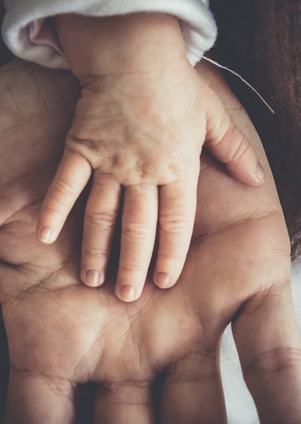
Parents and carers have responsibility for a child’s needs, safety and development. This includes:
Support physical, social, emotional development and wellbeing.
Support education.
Create security and a sense of home.
Meet basic needs (e.g. food, drink and clothing).
Provide a loving environment.
Support them to understand right and wrong.
Provide guidance as they progress through life.
Notes:
Lots more behind being a sucessfull parent
Taken from DofE

Slide 7
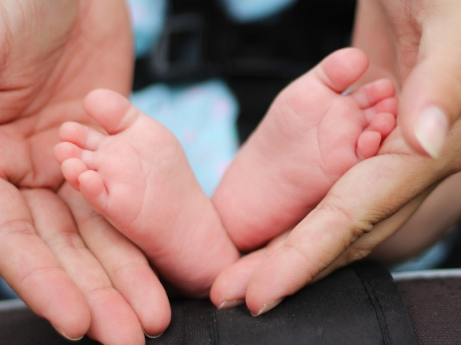

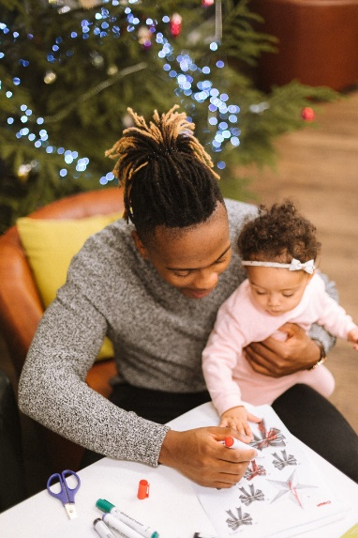




Timeline
In pairs, write down the responsibilities of parents at each stage of a child’s life on the timeline provided.
Underneath the timeline, note down what you think the main challenges for parents at each stage might be.
Can you identify any common responsibilities or challenges across all age ranges?
Notes:
Teacher Notes – Timeline (20 mins)
In pairs, ask students to write down the changing responsibilities of parents at each stage of a child’s life on Resource 2: Timeline. Once completed, ask them if they can identify any common themes across all age ranges (see Resource 2a: Timeline teacher suggestions for help).
Underneath the timeline, ask students to note down what the main challenges for parents at each stage might be (e.g. 0-1 – lack of sleep, constant supervision, 16-18 – supporting through exams, worrying about them leaving home). Feedback as a class, using Resource 2a: Timeline teacher suggestions to help you.
Challenge: Ask students to evaluate and explain which stage in a child’s life they think is most challenging for parents and why.
Support: Select fewer stages for students to complete (e.g. 0-1, 5-10 and 16-18)

Slide 8
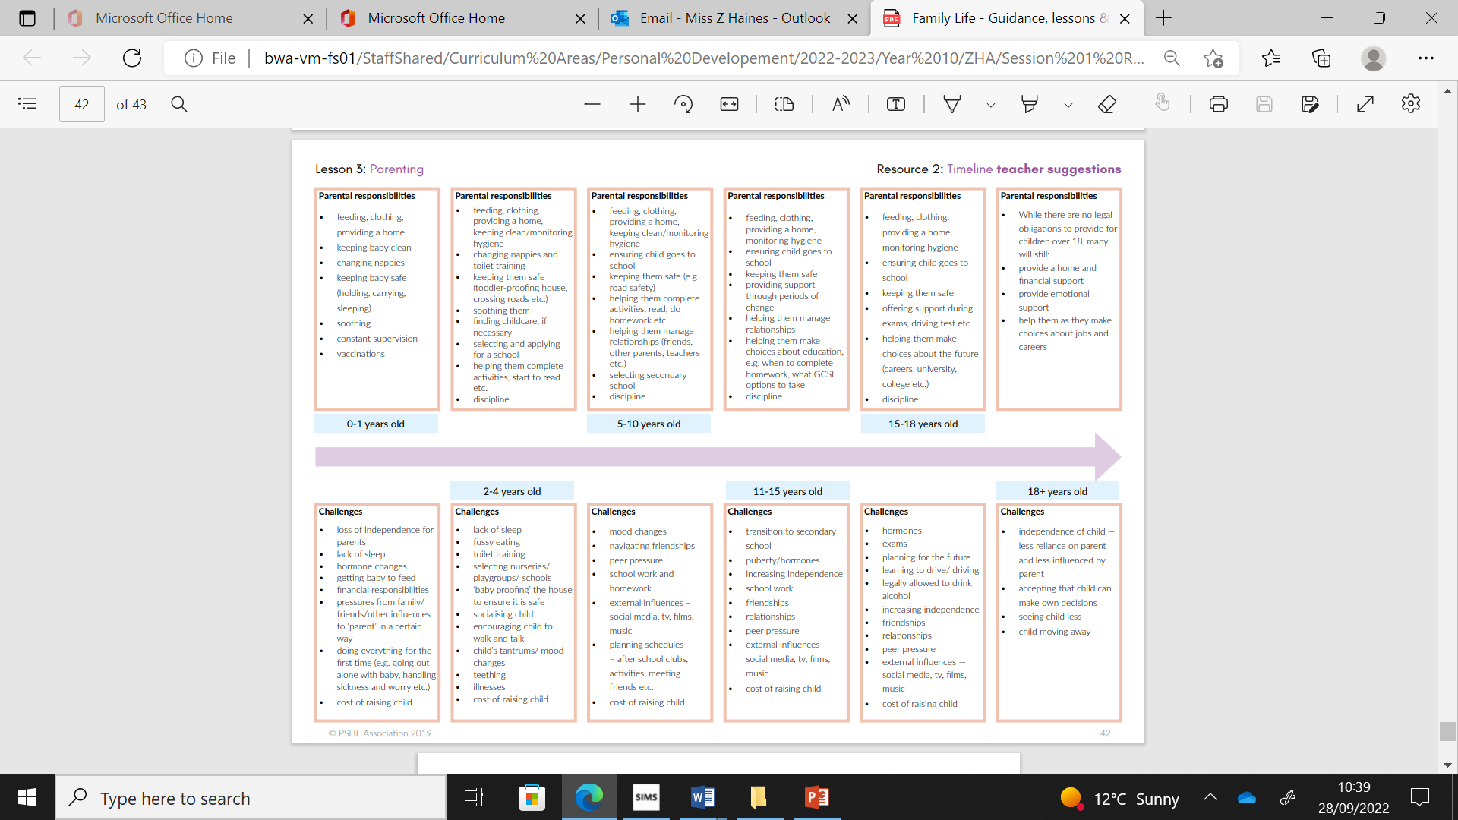

Slide 10

Top tips
As a group, come up with a list of 5 top tips for parents to help them tackle the responsibilities and challenges during the stage of a child’s life that you have been given.
Notes:
Teacher Notes – Top tips (10 mins)
Divide the class into 6 groups and give each one stage of a child’s life to focus on (0-1, 2-4 etc.). For their given stage in a child’s life, ask each group to come up with a list of 5 top tips for parents.
Then ask each group to feedback their tips to the rest of the class. Draw out any top tips that are shared across each age.
Finally, ask students how different families might respond to the challenges, e.g. families with single parents, mixed-sex couples, same-sex couples, grandparents, foster parents etc.
Challenge: Ask students what they think the single most important piece of advice they could give to parents is and explain why.
Support: Ask students to come up with 2-3 top tips, instead of 5.

Slide 11
Review it now
Parenting
Return to your mind map
Is there anything you would like to change?
Is there anything you would like to add?
Use a different colour pen or pencil to amend your draw and write and show how your thinking has developed or changed.
Notes:
Teacher Notes – End-point assessment (5 mins)
Return to the mind map from the start of the lesson. Using a different colour pen, ask students to reflect on anything they might change from the beginning of the lesson to now, and to add any new learning about issues relating to parenting, e.g. what are characteristics of successful parenting? This is an opportunity for you to gather evidence of the learning that has taken place and to inform your planning for subsequent learning.

Slide 12

Further support
Speak to a tutor, head of year or other trusted member of staff in the school
Childline www.childline.org.uk 0800 1111
Notes:
Teacher Notes – Signposting support
Remind pupils who they can talk to if they are worried.

