Slide 1
Exam Expectations – JCQ Guidelines 2024

Slide 3
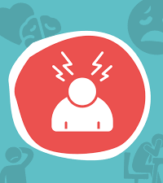
General exam stress-busting tips
Prioritise your time when revising
Make a revision timetable
Exercise and eat healthily
Take breaks from social media before exams
Put your worries into perspective
Improve your exam time management

Slide 4
Revision tips
Leave plenty of time to revise so that you don't have to do last- minute cramming.
Develop a timetable so that you can track and monitor your progress.
Allow time for fun and relaxation.
Take a short break as soon as you notice your mind is losing concentration, but don't get distracted.
Experiment with alternative revision techniques.
Don't drink too much coffee, tea or fizzy drinks; the caffeine will make your thinking less clear.
Regular moderate exercise will boost your energy, clear your mind, reduce feelings of stress and help you sleep better.

Slide 5
When exams start
Get organised the night before
Get everything ready for the exam the night before. You could talk to someone you trust to double check you’ve got everything sorted. Ensure that you know when your exams are plan your route to make sure that you have plenty of time to get here!
Try relaxation techniques
Avoid cramming in last-minute revision. This can be overwhelming and make you feel unprepared. You’ve put in the work, so focus on staying calm. Breathing exercises and grounding techniques can help dial down the stress before your exam.

Slide 6
Tips for the exam itself
It's natural to feel some exam nerves but don't panic.
The quickest and most effective way to eliminate feelings of stress and panic is to close your eyes and take several long, slow deep breaths.
Give yourself a mental pep-talk by repeating "I am calm" or "I know I will do fine"
Survey what’s in front of you
Prioritise what needs to be done
Pace yourself

Slide 7
Managing mental blocks in the exam
Memory recovery
Imagine you know the answer and see what comes to mind
Try not to keep staring at the question – brain research suggests the position of the eyes is important: look up as you try and remember it
Create a mind map of what you do remember – the power of association can trigger your memory Begin with questions you can answer – add anything you remember to your mind map while you are doing this

Slide 8
After the exam itself
Don't spend endless time criticising yourself for where you think you went wrong. Congratulate yourself for the things you did right, learn from the bits where you know you could have done better, and then move on.
Plan to reward yourself for your hard work. After the exam, do something you enjoy. If you are going to meet up with someone, you could agree with them that you will only talk about the exam for 5 minutes - or even not at all.
It’s important that you let the stress of the exam go, especially if you have more exams to sit.

Slide 9
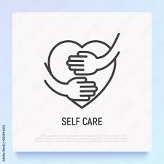
The importance of self-care
When exam stress hits, it might feel like there’s no time for self-care, or that you should be spending every second revising. Revising is important, but it’s going to be harder if you’re not looking after yourself.
Try to eat right, get some sleep, and give yourself a break – whether that’s gaming or hanging with your friends. We’re not robots – we all need a breather now and then.

Slide 10
Coping with life pressures
Sometimes, life can throw you curveballs that make it hard to study, like moving house, looking after a family member, dealing with a breakup or general life stress.
If life’s throwing you something like this, don’t feel you have to go it alone. Talk to someone you know or contact a helpline.
Whatever it is you’re going through, you deserve support

Slide 11
Reaching out for help
Everyone’s support network is different and only you can know best who you feel most comfortable to turn to. But when you’re ready to reach out, there are plenty of people who can help:
Family & friends
Staff in school
Your doctor
A faith leader
Helplines – See below
Childline: If you’re under 19 you can confidentially call, chat online or email about any problem big or small. 0800 11 11 – Open 24/7
Muslim Youth Helpline: Provides faith & culturally sensitive support for young Muslims. Online chat service available 0808 808 2008 – Open 4pm-10pm 365 days of the year
Samaritans: Whatever you’re going through, you can contact the Samaritans for support. They are a listening service and does not offer advice or intervention – 116123 – Open 24/7

Slide 12
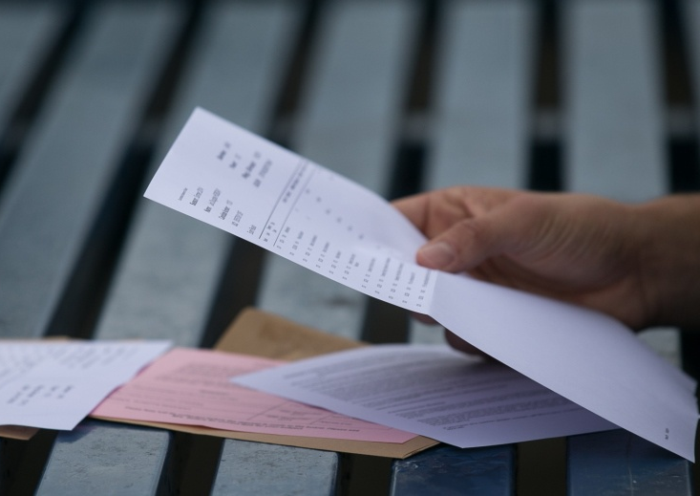
Notification of results:
Results will be available for collection in August – we will let you know the exact date & time at the start of the Summer break. If you are unable to collect results but would like another person to do so on your behalf, you must give written authorisation to us before results day.
No results will be given out by telephone
This Photo by Unknown author is licensed under CC BY-NC-ND.

